Slide 1
Topics to be Discussed
Kirchhoff’s Laws.
Loop-current Analysis.
Counting Independent Loops.
Mesh Analysis.
Supermesh Method.
Limitations of Mesh Analysis.
Planar Network.
Procedure for Mesh Analysis.
Node Voltages Analysis.
Supernode.
Counting Independent Nodes Nodal Analysis.
Choice Between the TWO.
Next

Slide 2
Electric Circuits
Circuit.
A circuit is a closed conducting path through which an electric current either flows or is intended flow.
Liner Circuit.
A linear circuit is one whose parameters are constant i.e. they do not change with voltage or current.
Non-linear Circuit.
It is that circuit whose parameters change with voltage or current.

Slide 3
Bilateral Circuit.
A bilateral circuit is one whose properties or characteristics are the same in either direction. The usual transmission line is bilateral, because it can be made to perform its function equally well in either direction.
Unilateral Circuit.
It is that circuit whose properties or characteristics change with the direction of its operation. A diode rectifier is a unilateral circuit, because it cannot perform rectification in both directions.
Electric Network.
A combination of various electric elements, connected in any manner whatsoever, is called an electric network.
Passive Network is one which contains no source of e.m.f. in it.
Active Network is one which contains one or more than one source of e.m.f.

Slide 4
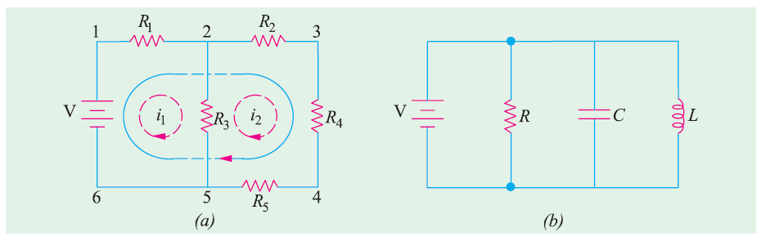
Node is a junction in a circuit where two or more circuit elements are connected together.
Branch is that part of a network which lies between two junctions.
Loop.
It is a close path in a circuit in which no element or node is encountered more than once.
Mesh.
It is a loop that contains no other loop within it.

Slide 5
Kirchhoff’s Laws
(1) KCL : Algebraic sum of currents meeting at a junction of conductors in a circuit is zero.
It is simply a restatement of the principle of conservation of charge.
Next

Slide 6
(2) KVL :The algebraic sum of voltages around a closed circuit or a loop is zero.
It is simply a restatement of the principle of conservation of energy.
Next

Slide 7
Polarity of Voltages
Note that polarity of the voltage (emf) across a battery does not depend upon the assumed direction of current.
Next

Slide 8
Applying KVL
Select a closed loop.
Mark the voltage polarity (+ and -) across each element in the closed loop.
Note that polarity of the voltage (emf) across a battery does not depend upon the assumed direction of current.
Go round the selected loop, and add up all the voltages with + or – signs.
Next

Slide 9
Any one of the following two rules can be followed :
(i) Rule 1 : While travelling, if you meet a voltage rise, write the voltage with positive sign ; if you meet a voltage drop, write the voltage with negative sign.
(ii) Rule 2 : While travelling, write the voltage with positive sign if + is encountered first; write the voltage with negative sign if – is encountered first.
We shall be following Rule 1, as it has a strong analogy with the physical height (altitude) of a place.
Next

Slide 10
Important Note about KVL
The assumed direction of current through a resistor and the polarity of voltage across it are always in conformity.
The end into which the current enters is marked positive.
Passive-element sign convention.
Next

Slide 11
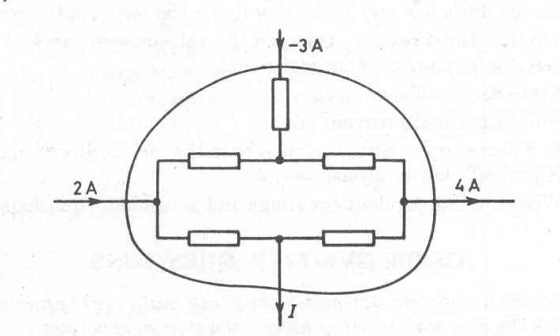
Example 1 : Determine the value of current I.
2 – 3 – I – 4 = 0 or I = -5 A
Next

Slide 12
Example 2
+ -
+ -
+ |
+ |
+ |
Using KCL and KVL, determine the currents i_{x} and i_{y} in the network shown.
Next

Slide 13
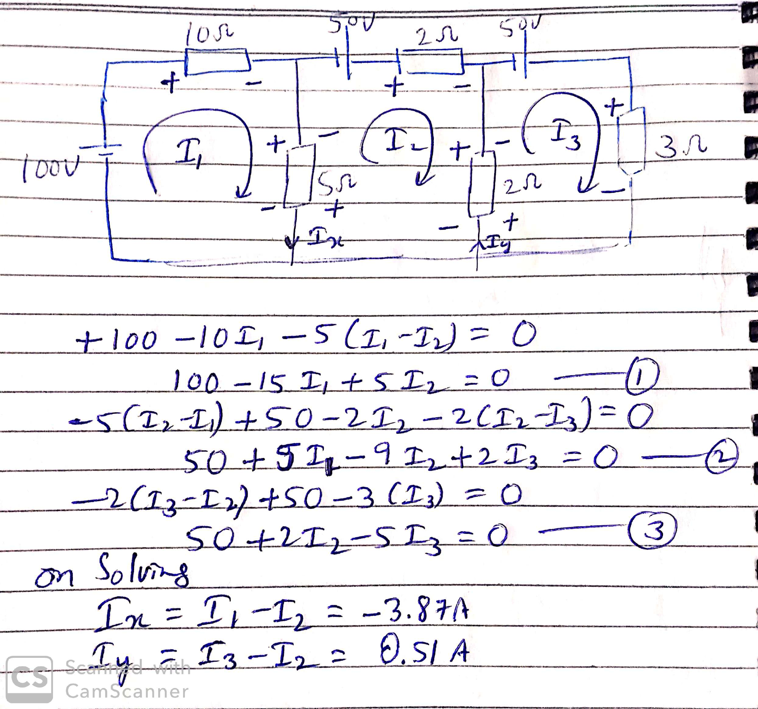

Slide 14
Another method : Using KCL, the currents in other branches are marked as shown. Writing KVL equations for the loops 1, 2 and 3,
Next

Slide 15
Writing the above equations in matrix form,
Click
Using Calculator, we solve for I_{x} and I_{y},
Click
Next

Slide 16
Loop-current Analysis
Loop analysis is systematic method of network analysis.
It is a general method and can be applied to any electrical network, howsoever complicated it may be.
It is based on writing KVL equations for independent loops.
A loop is a closed path in a network.
A node or a junction is a point in the network where three or more elements have a common connection.
Next
Notes:
Examples of planar network Fig.5.21 ,22.

Slide 17
Before the loop analysis can be applied to a network, we must first check that it has only voltage sources (independent or dependent).
Any current source must be transformed into its equivalent voltage source.
Sometimes, it is a difficult task to identify independent loops in a network.
The method of loop analysis can be best understood by considering some examples.
Next

Slide 18
Example 3
Find the voltage across the 2-Ω resistance.
Next

Slide 19
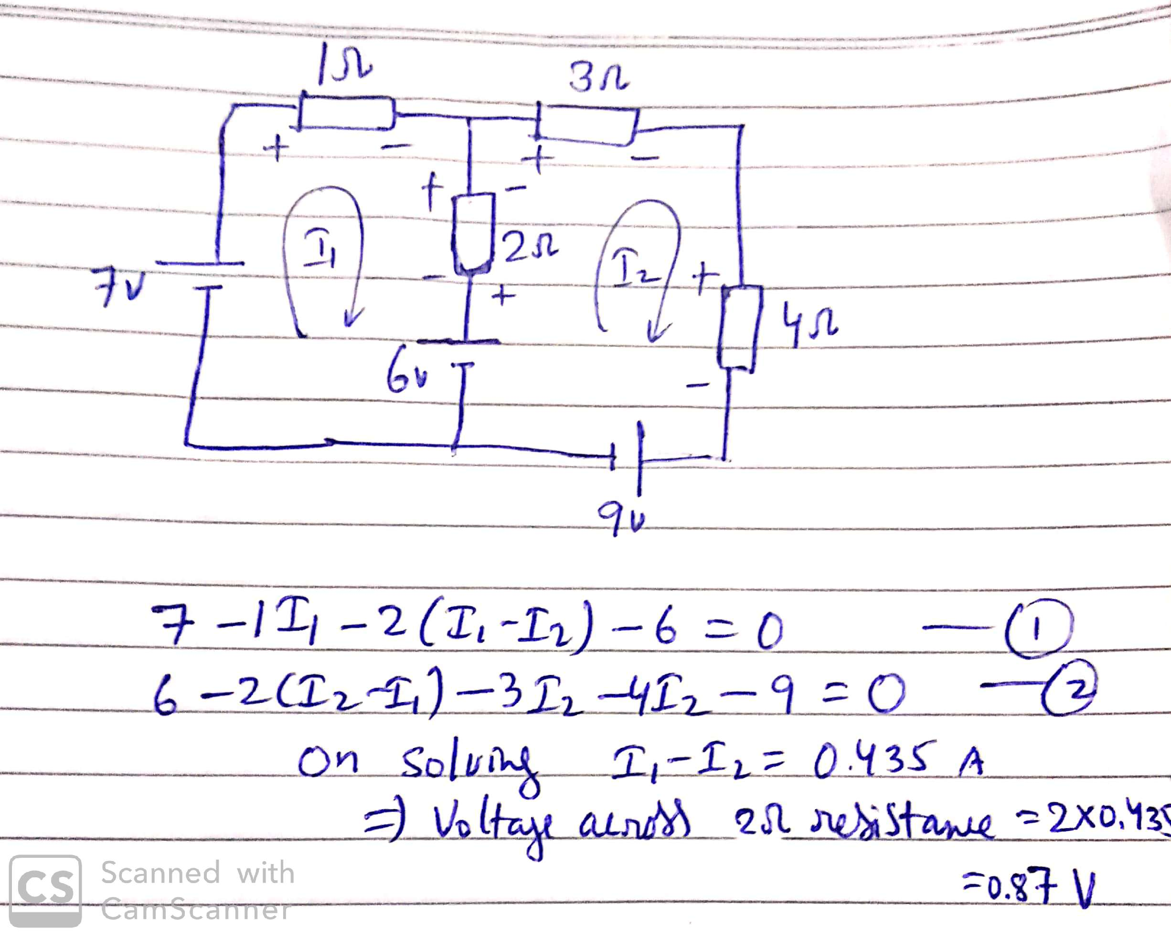

Slide 20
Benchmark Example 4
Consider the benchmark example, and solve it by using loop-current analysis.
Next

Slide 21
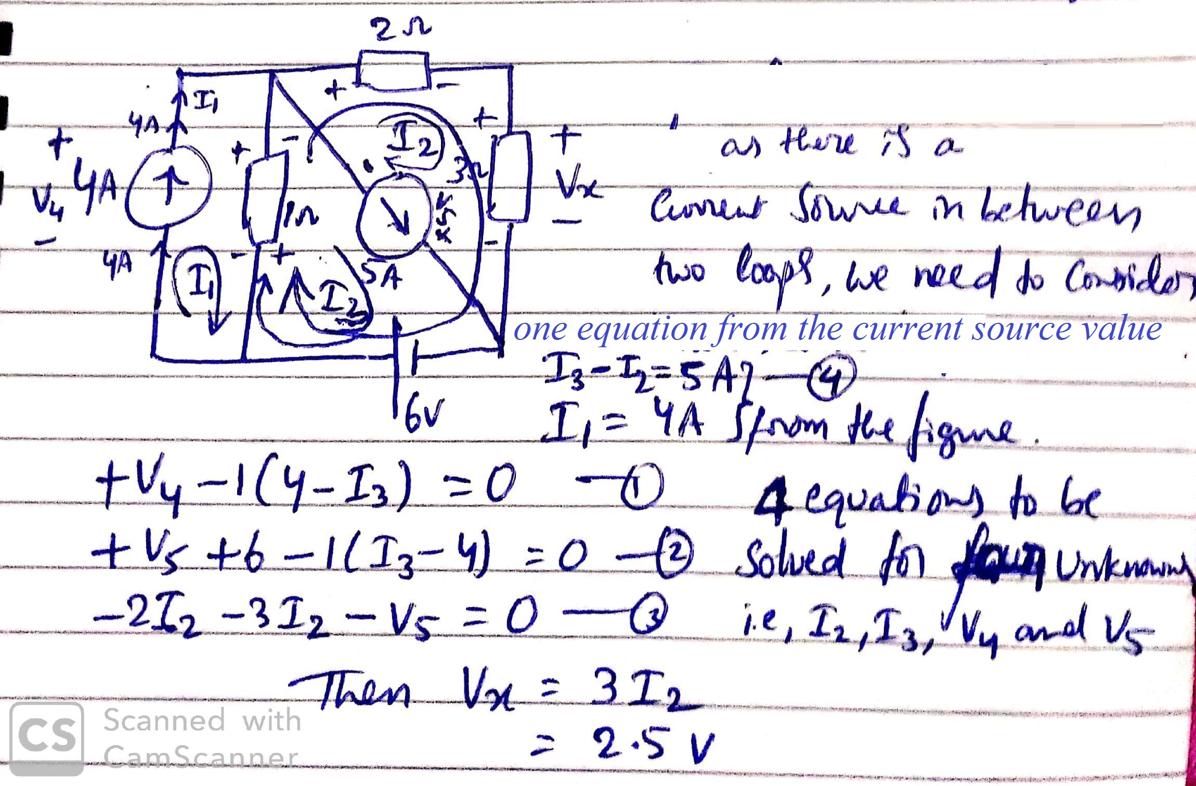

Slide 22
Another method :
We note that the given circuit has one independent loop and two constrained loops.
Our aim is to determine the voltage across 3-Ω resistance.
So, we should select the unknown loop current I passing through 3-Ω resistance (but not through any current source).
The two known loop currents of 4 A and 5 A are marked to flow in the two loops as shown.
Next

Slide 23
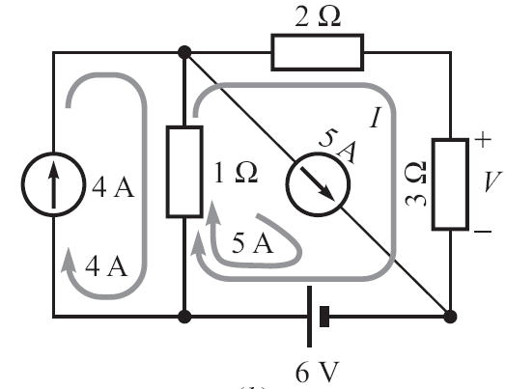
Writing KVL equation around the loop of I, we get
Click
Therefore, the unknown voltage, v = 3I = 2.5 V.
Next

Slide 24
MESH ANALYSIS
In circuit terminology, a loop is any closed path.
A mesh is a special loop, namely, the smallest loop one can have.
In other words, a mesh is a loop that contains no other loops.
Mesh analysis is applicable only to a planar network.
However, most of the networks we shall need to analyze are planar.
Next

Slide 25
Once a circuit has been drawn in planar form, it often looks like a multi-paned window.
Each pane is a mesh.
Meshes provide a set of independent equations.
Next

Slide 26
Mesh Currents
By definition, a mesh-current is that current which flows around the perimeter of a mesh. It is indicated by a curved arrow that almost closes on itself.
Branch-currents have a physical identity. They can be measured.
Mesh-currents are fictitious.
The mesh analysis not only tells us the minimum number of unknown currents, but it also ensures that the KVL equations obtained are independent.
Next

Slide 27
Illustrative Example 5
Let us consider a simple network having only two meshes.
Although the directions of the mesh currents are arbitrary; but all must be either clockwise or anticlockwise.
We shall always choose clockwise mesh currents.
This results in a certain error-minimizing symmetry.
Note that by taking mesh currents, the KCL is automatically satisfied.
Next

Slide 28
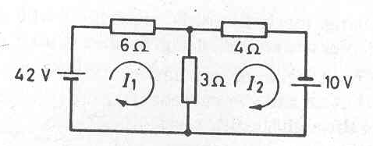
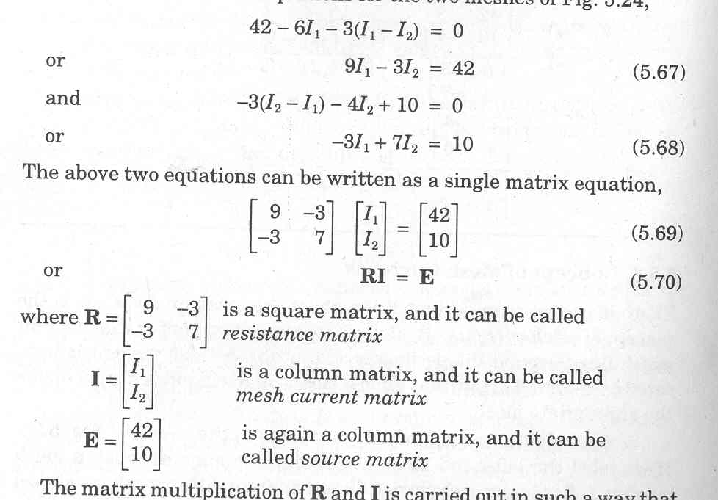
Next

Slide 29
Resistance Matrix
Mesh current matrix
Source matrix
Next

Slide 30
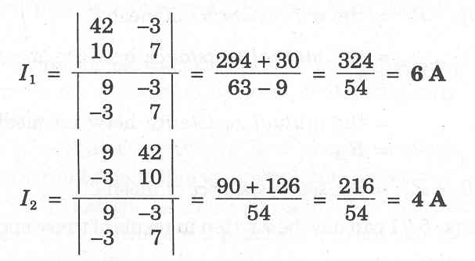
Applying Crammer’s rule :
The current in 3-ohm resistor is I₁ – I₂ = 6 – 4 = 2A
Next

Slide 31
Scientific Calculator
Now-a-days, advanced scientific calculator (such as CASIO fx-991ES) are available.
Quadratic and simultaneous equations (up to three variables), can be directly solved just by keying in the constants of the equation.
Also, you can do calculations with complex numbers (even in mixed mode – polar and Cartesian), as is often required for the analysis of ac circuits
Using a good scientific calculator not only saves a lot of time, but also reduces the possibility of making errors.
Next

Slide 32
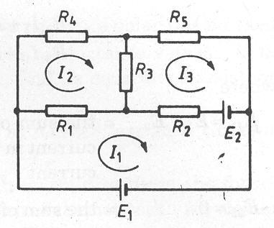
Three-mesh Network
Write the three equations for the three meshes and put them in a matrix form.
Next

Slide 33
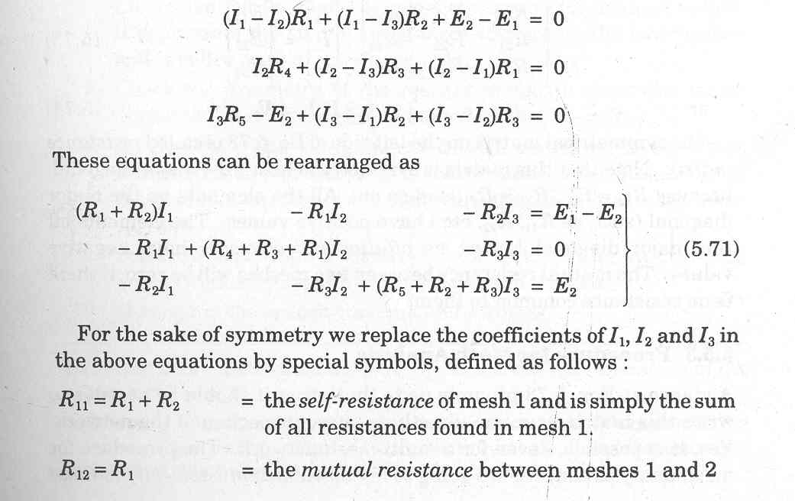
Next

Slide 34
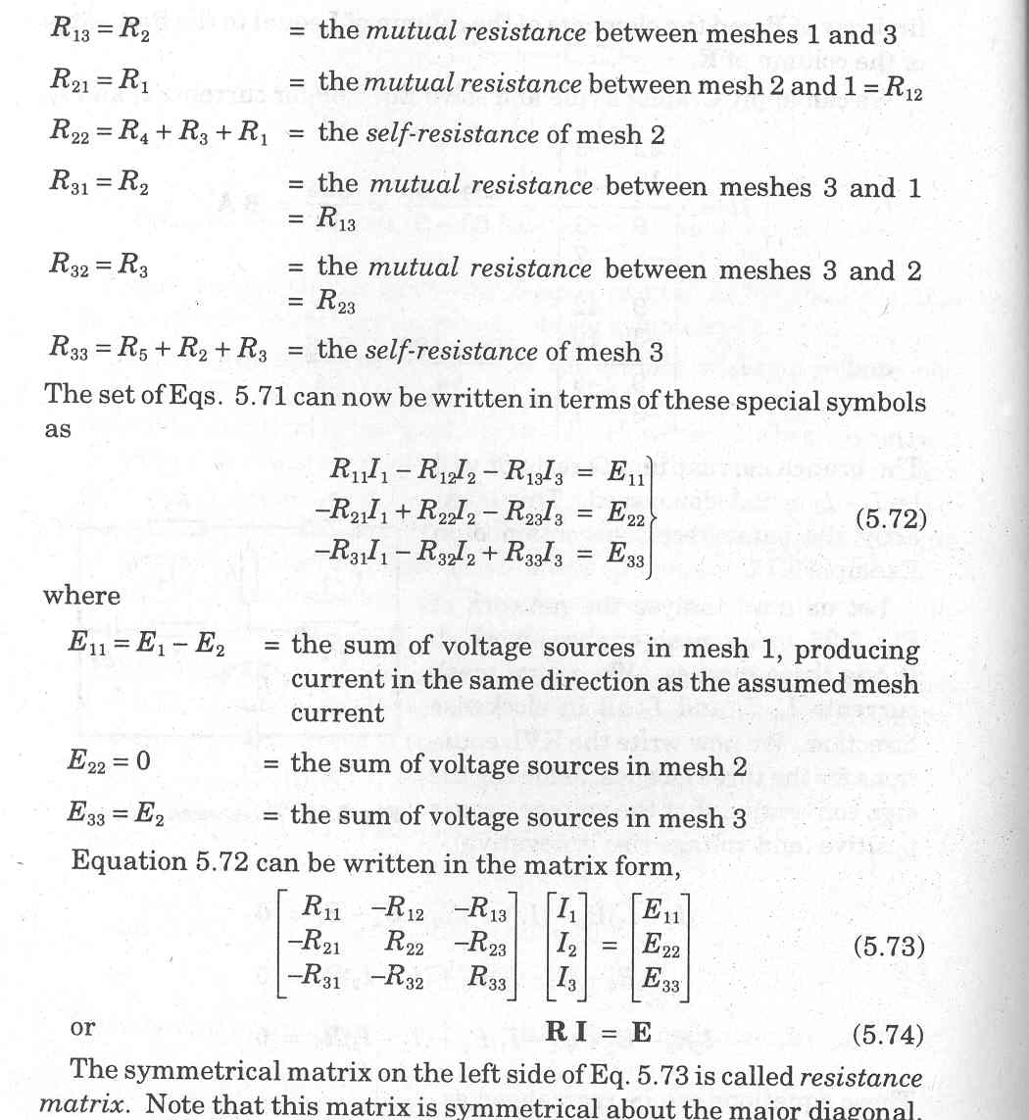
Next

Slide 35
Self-resistance of mesh 1
Mutual resistance between mesh 1 and 2.
Next

Slide 36
The Resistance Matrix
It is symmetrical about the major diagonal, as R₁₂ = R₂₁, R₁₃ = R₃₁, etc.
All the elements on the major diagonal have positive values.
The off-diagonal elements have negative values.
The mutual resistance between two meshes will be zero, if there is no resistance common to them.
Next

Slide 37
Mesh Analysis Limitations
It is applicable only to those planar networks which contain only independent voltage sources.
If there is a practical current source, it can be converted to an equivalent practical voltage source.
Next

Slide 38
Procedure for Mesh Analysis
Make sure that the network is planar.
Make sure that it contains only independent voltage sources.
Assign clockwise mesh currents.
Write mesh equations in matrix form by inspection.
An element on the principal diagonal is the self-resistance of the mesh. These elements are all positive. An element off the major diagonal is negative (or zero), and represents the mutual resistance.
Next

Slide 39
Check the symmetry of resistance matrix about the major diagonal.
An element of the voltage source column matrix on the right side represents the algebraic sum of the voltage sources that produce current in the same direction as the assumed mesh current.
Solve the equations to determine the unknown mesh currents, using Calculator.
Determine the branch currents and voltages.
Next

Slide 40
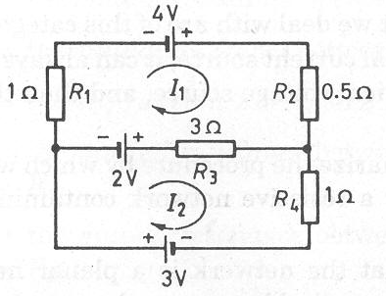
Example 6
Determine the currents in various resistances of the network shown.
Next

Slide 41
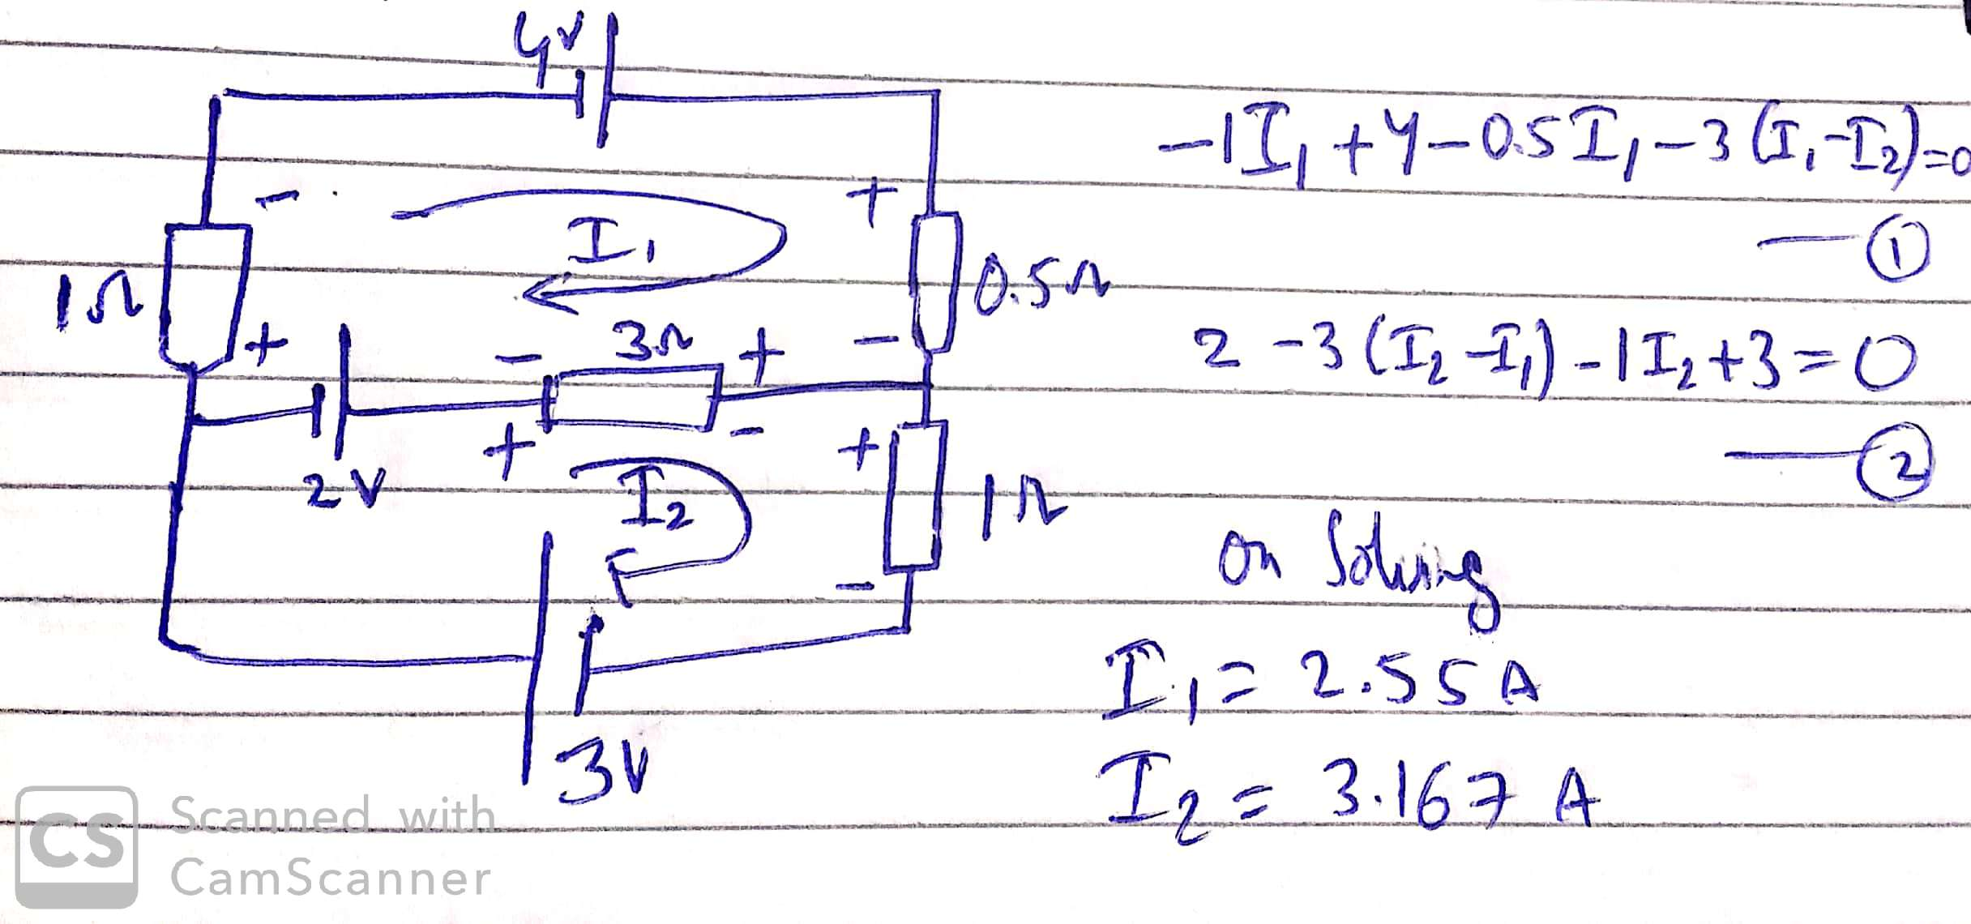

Slide 42
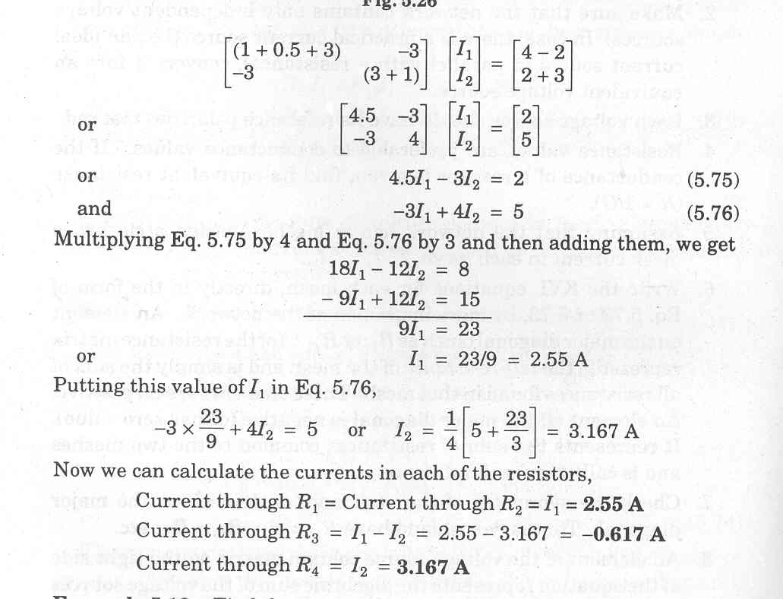
Another method :
Writing the mesh equations by inspection,
Click
Solving,
Click
we get I₁ = 2.55 A, I₂ = 3.167 A
Next

Slide 43
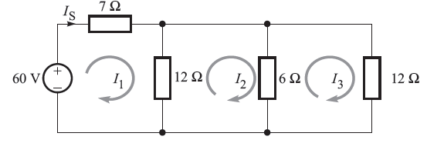
Example 7
Find the current drawn from the source in the network, using mesh analysis.
Try to solve using the method discussed in the classroom
Next

Slide 44
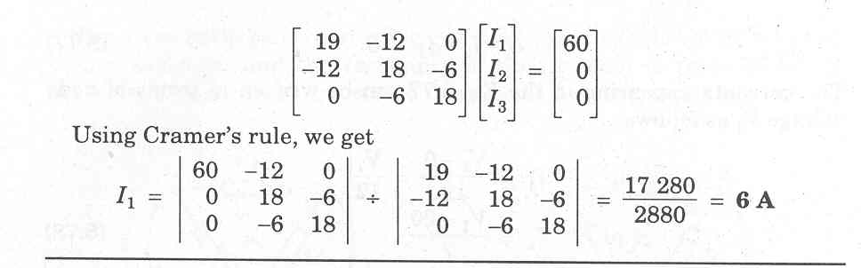
Another method :
Writing the mesh equations by inspection,
Using Calculator, we get
Click
Next

Slide 45
Example 8
Apply mesh analysis to determine current through 7-Ω resistance in the given network.
Next

Slide 46
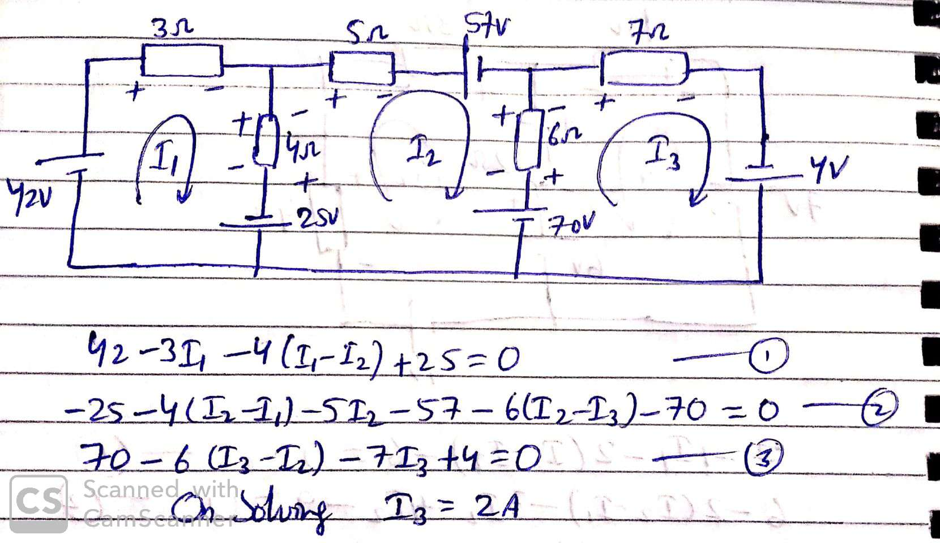

Slide 47
Another method :
The given network is a planar network having independent voltage sources.
It has three meshes for which the mesh currents I₁, I₂, and I₃ are marked all with clockwise directions.
By inspection, the matrix equation is written as
Click
Next

Slide 48
Solving the above equation for I₃,
Click
Next

Slide 49
Node Voltages Analysis
It is dual of the Mesh Analysis.
It involves the application of KCL equations, instead of KVL.
One of the nodes is taken as reference or datum or ground node. It is better to select the one that has maximum number of branches connected.
The reference node is assumed to be at ground or zero potential.
Next

Slide 50
The potentials of all other nodes are defined w.r.t. the reference node.
KCL equations are written, one for each node, except the reference node.
The equations are solved to give node voltages.
Current through any branch and voltage at any point of the network can be calculated.
Next

Slide 51
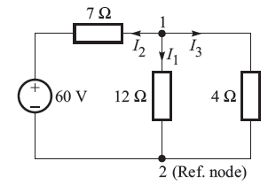
Example 9
Using the node voltage method, determine the current I_{2.}
Next

Slide 52
Solution : It has only two nodes. Node 2 has been taken as reference node. The currents in various branches have been assumed. Writing the KCL equations,
Next

Slide 53
How to Handle Voltage Sources
If one terminal of a voltage source with a series resistance is grounded (as in the Example 8), the KCL equation can be written in terms of this voltage.
Difficulty arises, if a circuit contains floating voltage sources.
A voltage source is floating if its neither terminal is connected to ground.
If possible, first transform the voltage sources into current sources.
Next

Slide 54
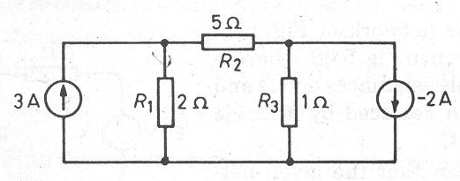
Example 10
Using nodal analysis, determine the current through the 2-Ω resistor in the network given.
Next

Slide 55
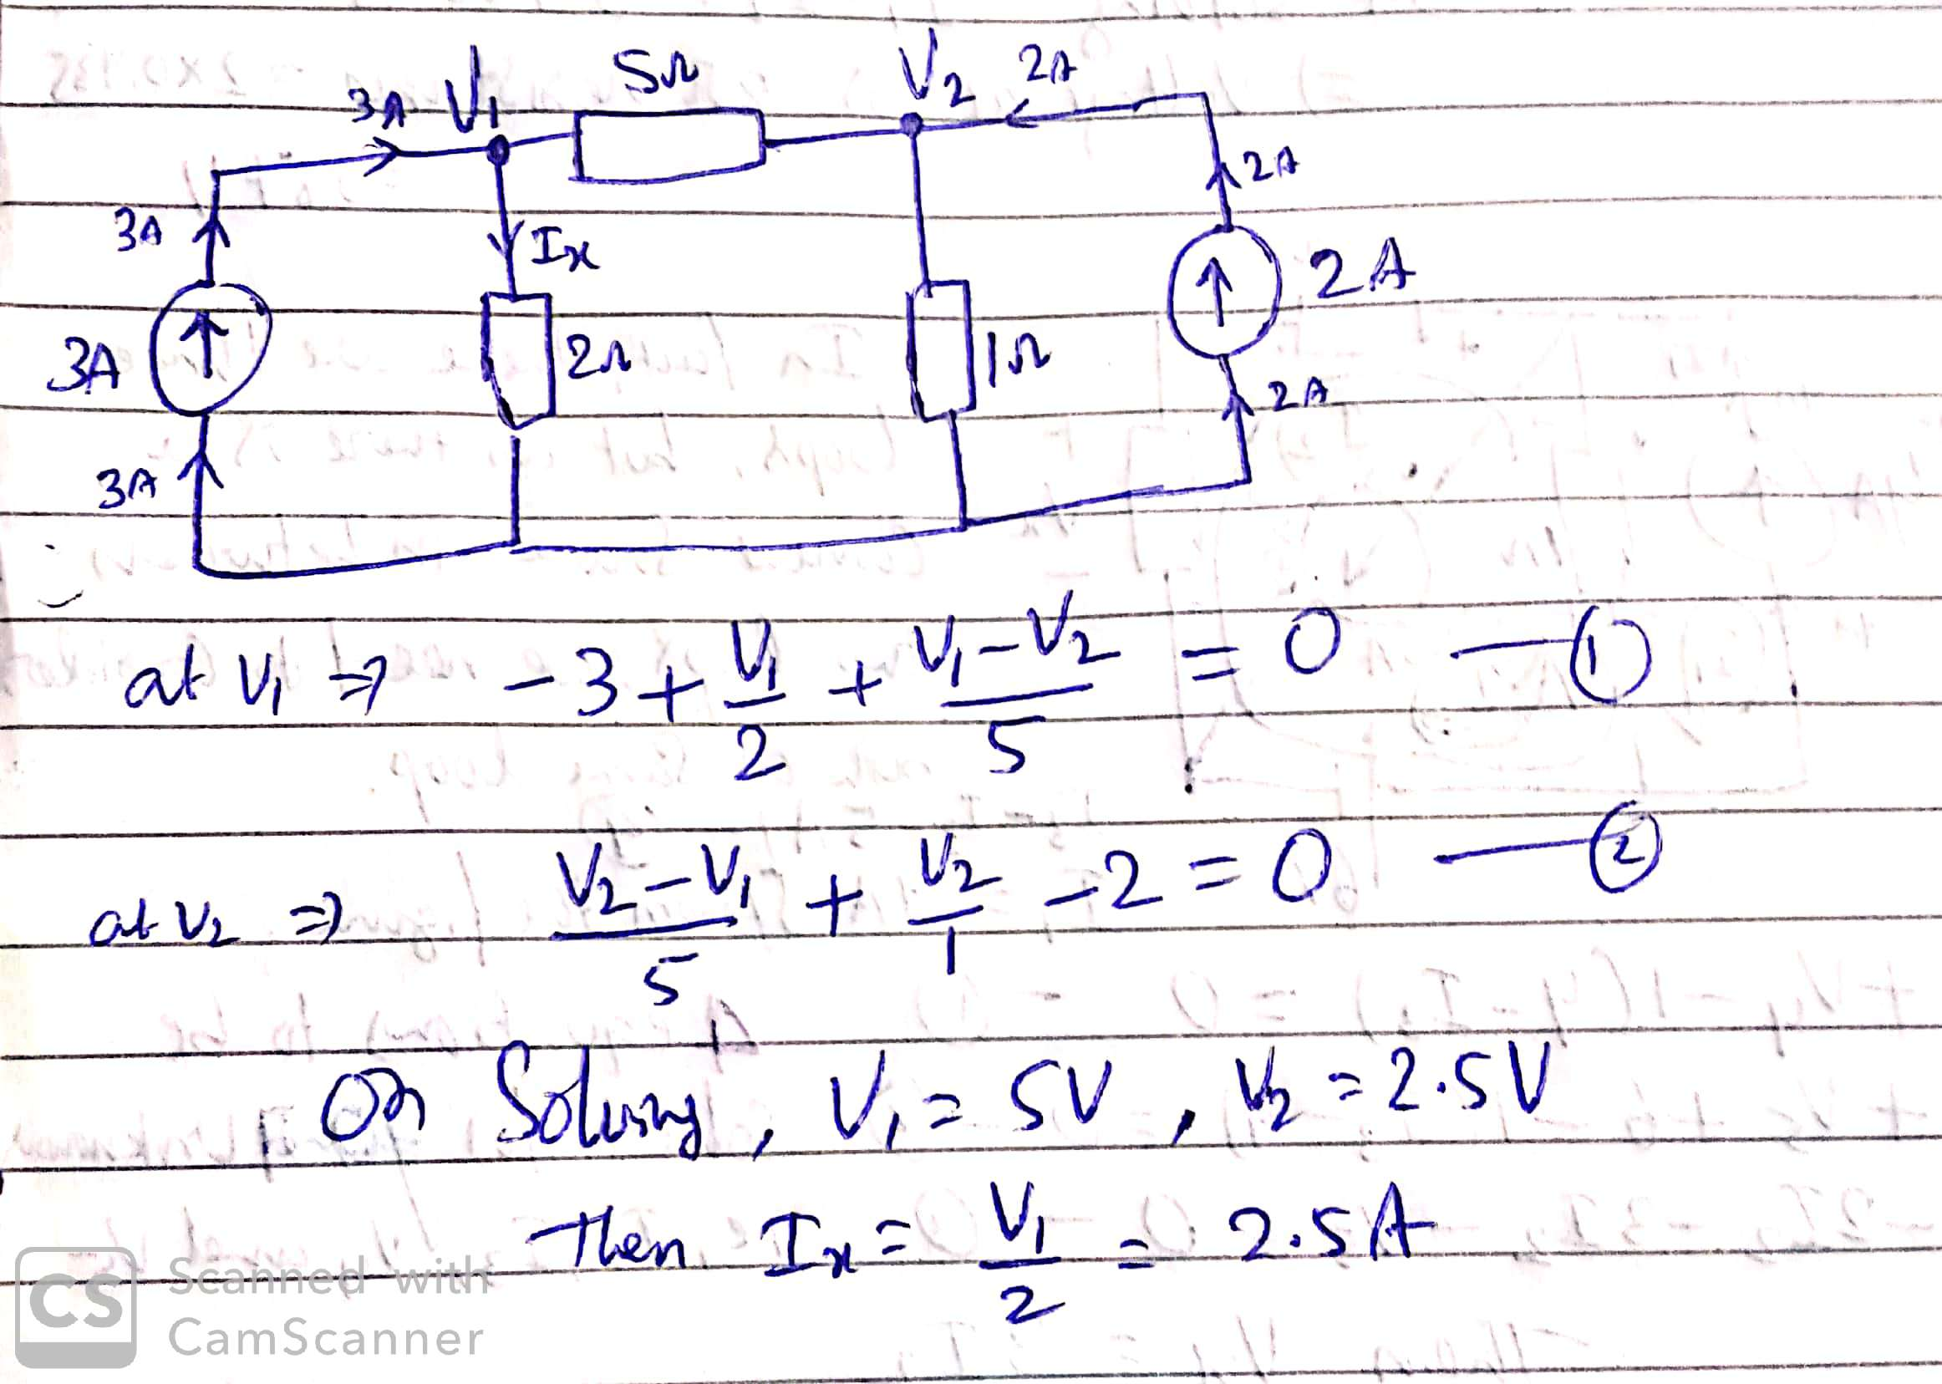

Slide 56
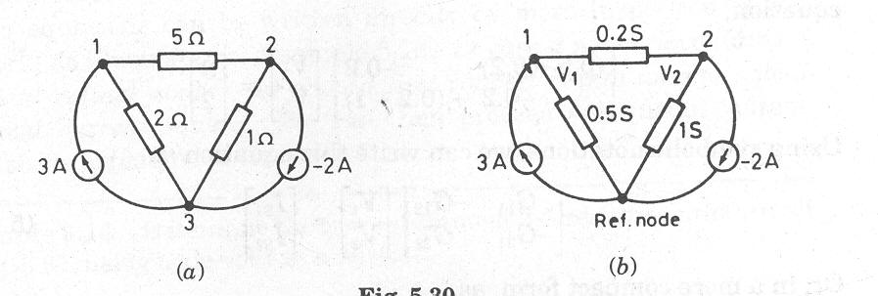
Another method :
It is much simpler to write the KCL equations, if the conductance (and not the resistances) of the branches are given.
Next

Slide 57
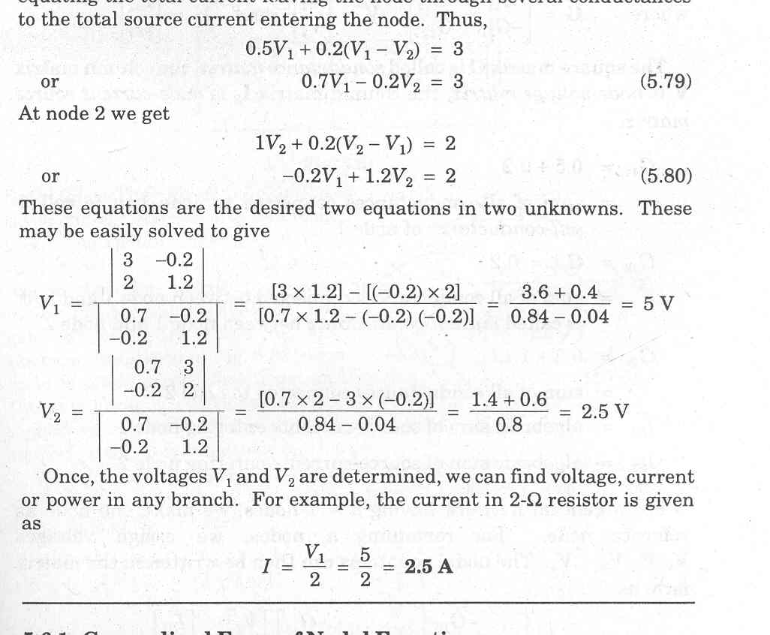
It has 3 nodes. So, we have to write KCL equations for only 2 nodes.
We just equate the total current leaving the node through several conductances to the total source-current entering the node.
At node 1,
At node 2,
Next

Slide 58
Writing the above equations in matrix form,
Solving for V₁, using Calculator, we get
Click
Finally, the current in the 2-Ω resistor,
Next

Slide 59
Nodal Analysis
The above examples suggests that it is possible to write the nodal analysis equations just by inspection of the network.
Such technique is possible if the network has only independent current sources.
All passive elements are shown as conductances, in siemens (S).
Next

Slide 60
In case a network contains a practical voltage source, first convert it into an equivalent practical current source.
Write the Conductance Matrix, Node-Voltage Matrix and the Node-Current Source Matrix, in the same way as in the Mesh Analysis.
Next

Slide 61
Another method :
Let us again tackle Example 10, by writing the matrix equations just by inspection.
Next

Slide 62
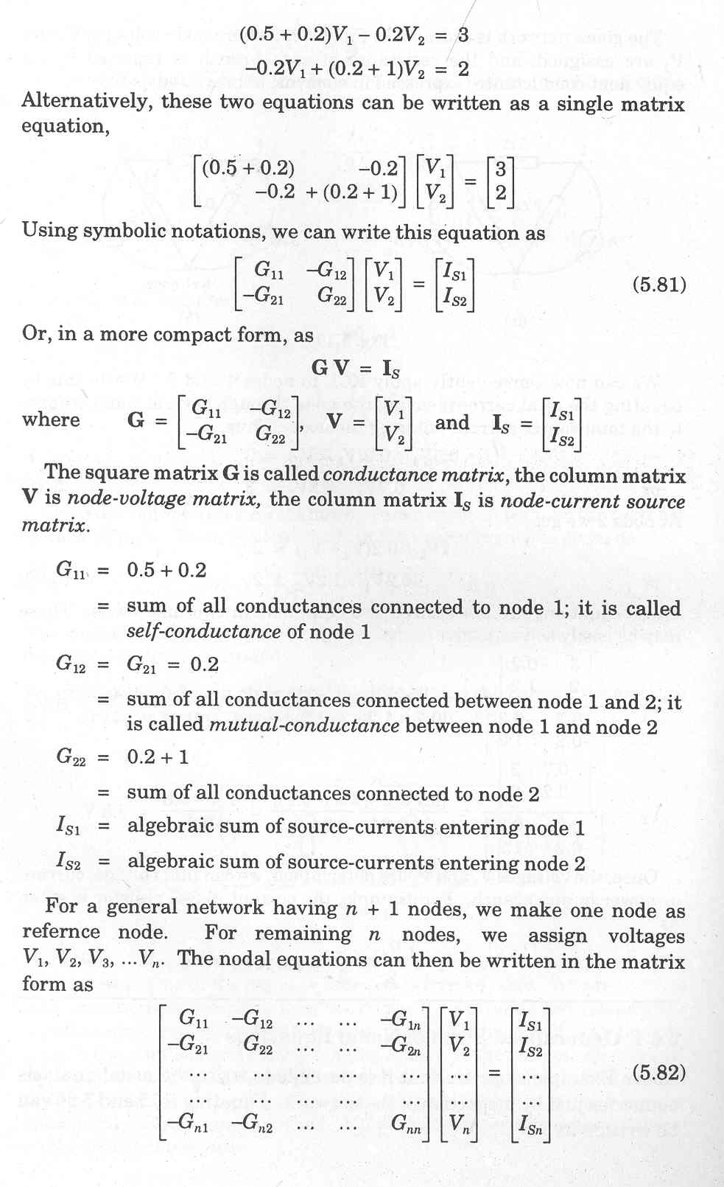
Conductance matrix. G₁₁ = Self-conductance of node 1. G₁₂= Mutual conductance between node 1 and 2.
Next

Slide 63
Node-voltage Matrix.
Node current-source Matrix.
Note that all the elements on the major diagonal of matrix G are positive.
All off-diagonal elements are negative or zero.
Next

Slide 64
Example 11
Solve the following network using the nodal analysis, and determine the current through the 2-S resistor.
When the units are S (not Ω), the values given are conductances in siemens.
Next

Slide 65
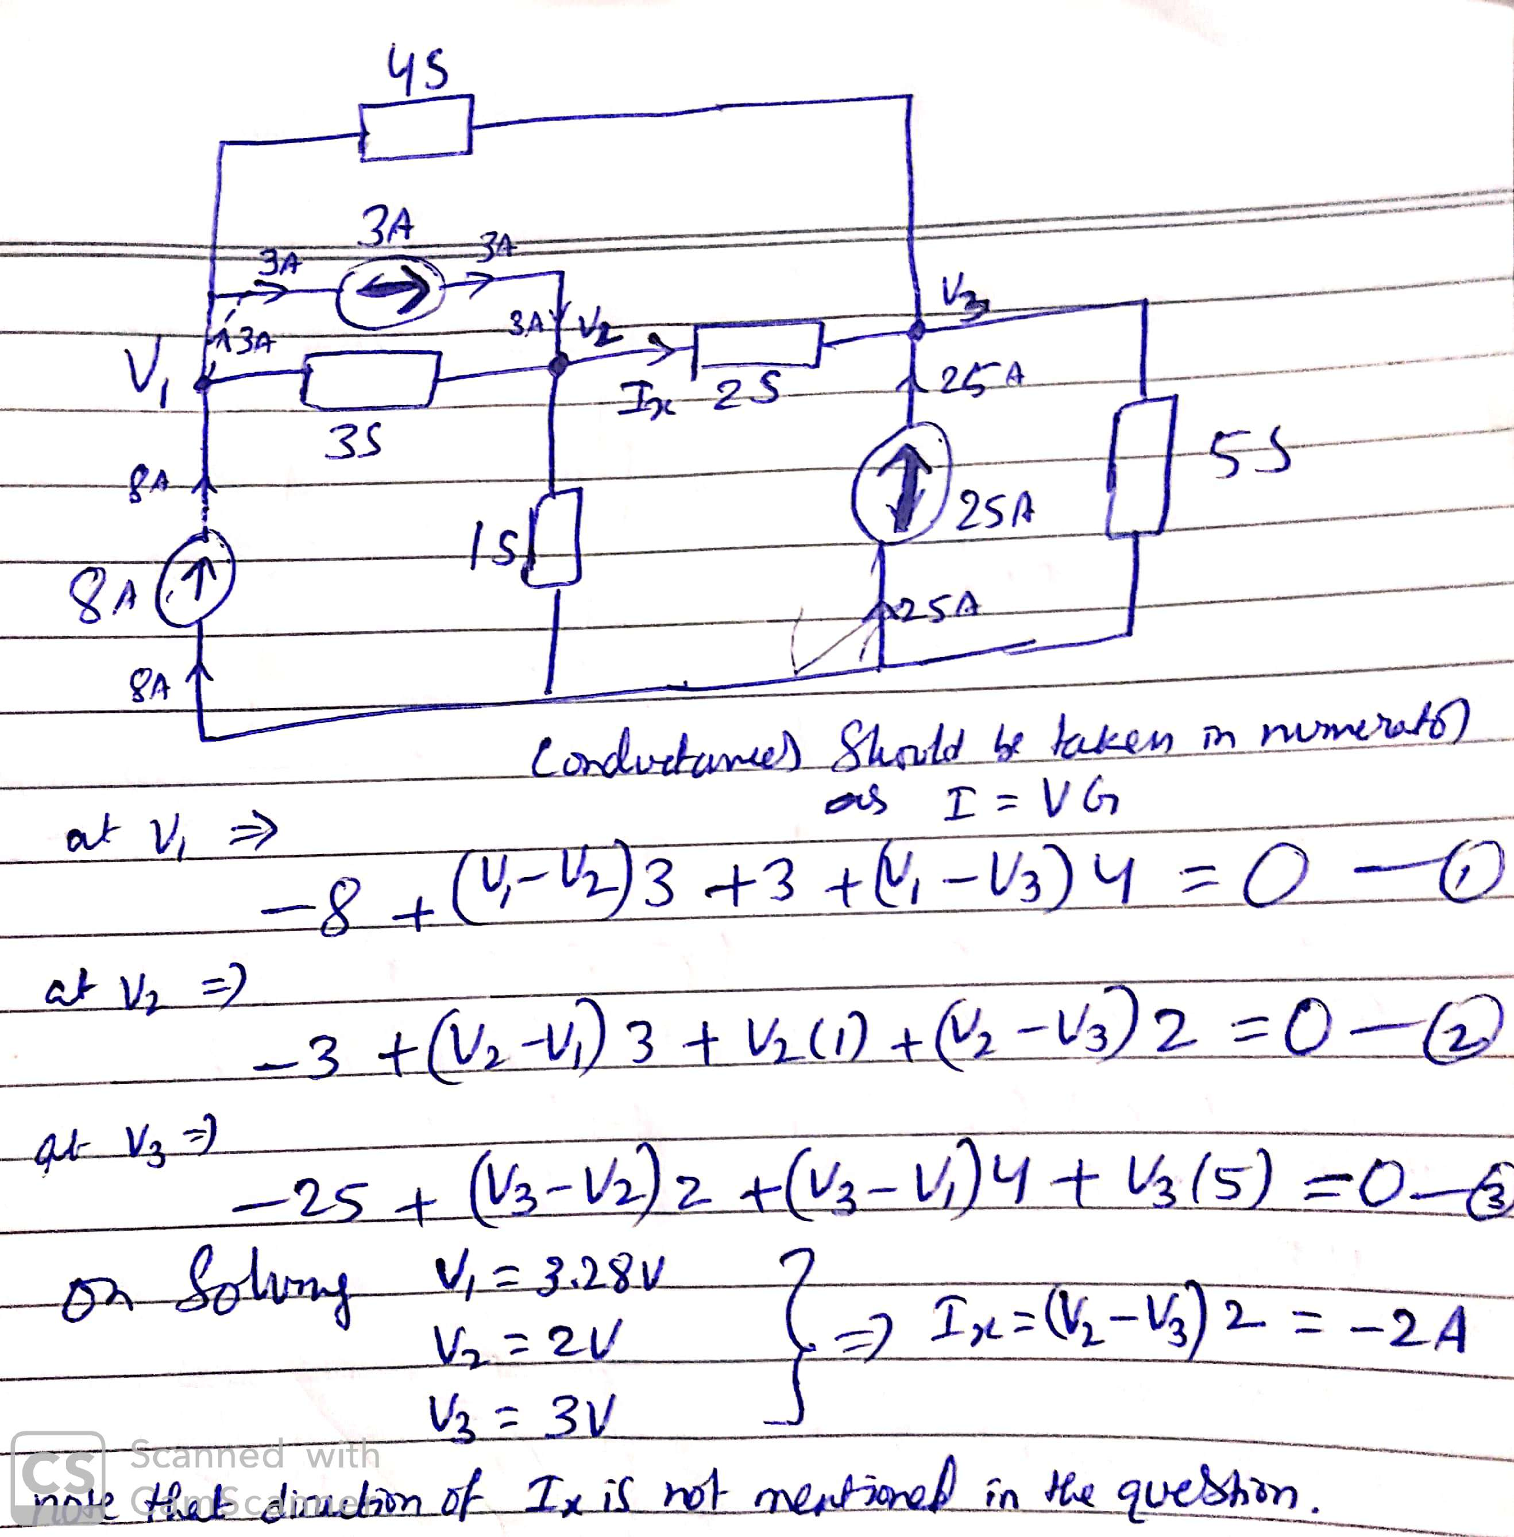

Slide 66
Another method :
Next

Slide 67
We can write the nodal voltage equation in matrix form, directly by inspection :
Click
Next

Slide 68
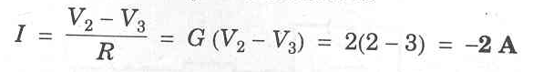
Using Calculator, we get
Click
Finally, the current through 2-S resistor is
Click
Next

Slide 69
Choice Between the TWO
We select a method in which the number of equations to be solved is less.
The number of equations to be solved in mesh analysis is
b – (n – 1)
The number of equations to be solved in nodal analysis is
(n – 1)
Next

Slide 70
Review
Kirchhoff’s Laws.
Loop-current Analysis.
Counting Independent Loops.
Mesh Analysis.
Supermesh Method.
Limitations of Mesh Analysis.
Planar Network.
Procedure for Mesh Analysis.
Node Voltages Analysis.
Supernode.
Counting Independent Nodes
Nodal Analysis.
Choice Between the TWO.
Next

Slide 71
Out of Syllabus
Next

Slide 72
How to Handle Current Sources
If a circuit has current sources, a modest extension of the standard procedure is needed.
There are three possible methods.
Next

Slide 73
First Method
If possible, transform the current sources into voltage sources.
This reduces the number of meshes by 1 for each current source.
Apply the standard procedure of mesh analysis to determine the assumed mesh currents.
Go back to the original circuit, and get additional equations, one for each current source.
Next

Slide 74
Example 8
Solve the following circuit for the three mesh currents.
Next

Slide 75
Solution :
We convert the 13-A current source in parallel with 5-Ω resistor into an equivalent 65-V voltage source in series with 5-Ω resistor.
This reduces the number of meshes to two.
Next

Slide 76
We can write the mesh equations in the matrix form just by inspection,
Click
We now go back to the original circuit. Obviously, the current through the current source is
Next

Slide 77
Second Method
We can assign unknown voltages to each current source.
Apply KVL around each mesh, and
Relate the source currents to the assumed mesh currents.
This is generally a difficult approach.
Next

Slide 78
Third Method (Supermesh Method)
Create a supermesh from two meshes that have a current source as a common element.
The current source is in the interior of the supermesh.
Thus, the number of meshes is reduced by 1 for each current source present.
If the current source lies on the perimeter of the circuit, then ignore the single mesh in which it is found.
Apply KVL to the meshes and supermeshes.
Next

Slide 79
Example 9
Solve the circuit of Example 5, using supermesh method.
Solution :
Next

Slide 80
Going along the dotted arrow, the KVL equation for this supermesh is
Click
The KVL equation for mesh 1 is
Click
We have only two equations for three unknowns.
The third equation is obtained by applying KCL to either node of the current source
Next

Slide 81
Thus, we have
These three equations can be put in the matrix form,
Using Casio fx-991ES, we directly get
Click
Which is same result as obtained in Example 7.
Next

Slide 82
Constrained Node or SUPERNODE
There is another way which uses the concept of constrained node or supernode.
This method is especially suitable for the circuits having a floating voltage source with no series resistance.
The two ends of a voltage source cannot make two independent nodes.
Hence, we treat these end nodes together as a ‘supernode’.
The supernode is usually indicated by the region enclosed by a dotted line.
The KCL is then applied to both nodes at the same time.
Next

Slide 83
Counting Independent Nodes
It is a node whose voltage cannot be derived from the voltage of another node.
First turn off all sources, and then count all the nodes separated by resistors.
The number of independent nodes is one less than this number.
Next

Slide 84
Example 12
Determine the current through 4-Ω resistor in the circuit given below.
Next

Slide 85
Solution :
Here, the voltages at nodes a and b are not independent.
The two node voltages are related as
We can treat the two constrained nodes a and b, as a supernode.
Now, writing KCL for this supernode, we get
Click
Next

Slide 86
Applying KCL to node c
Click
Above equations can be written in the matrix form,
Solve the above equation
Next

Slide 87
We solve the above equations using calculator to get
Click
Finally, the current through 4-Ω resistor is
Next

Slide 88
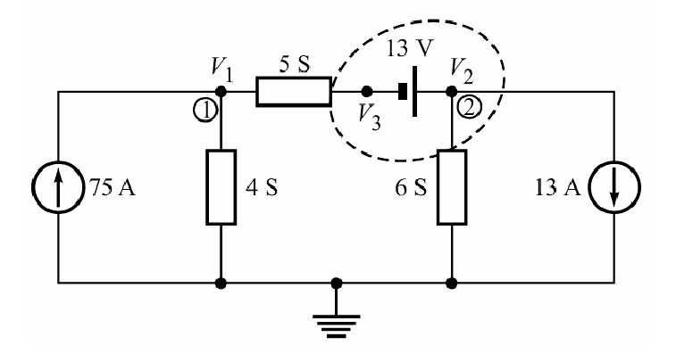
Example 16
Find the node voltages in the circuit shown .
Next

Slide 89
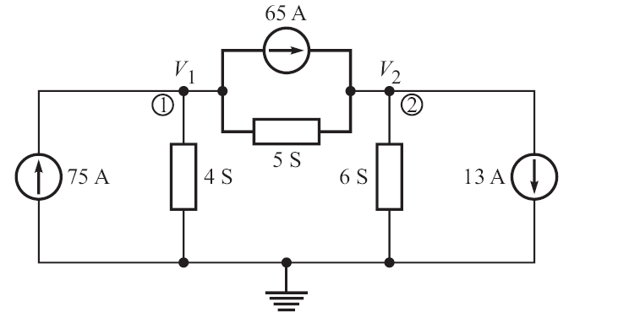
Solution :
First Method
Transform the 13-V source and series 5-S resistor to an equivalent current source of 65 A and a parallel resistor of 5 S
Next

Slide 90
Now, we can write the nodal equations in matrix form for the two nodes just by inspection,
Click
Click
Now, from the original circuit shown, we get
Click
Next

Slide 91
Second Method
We use the concept of supernode. The voltage source is enclosed in a region by a dotted line, as shown in figure. The KCL is then applied to this closed surface:
Click
The KCL equation for node 1 is
For three unknowns, we need another independent equation. This is obtained from the voltage drop across the voltage source,
Writing the above equations in matrix form,
Next

Slide 92
Solving, we get
Click
Which are the same as obtained by first method.
In general, for the supernode approach, the KCL equations must be augmented with KVL equations the number of which is equal to the number of the floating voltage sources.
Next

Slide 93
To Solve such Problems
We take help
of
Star-Delta
Transformation.

Slide 94
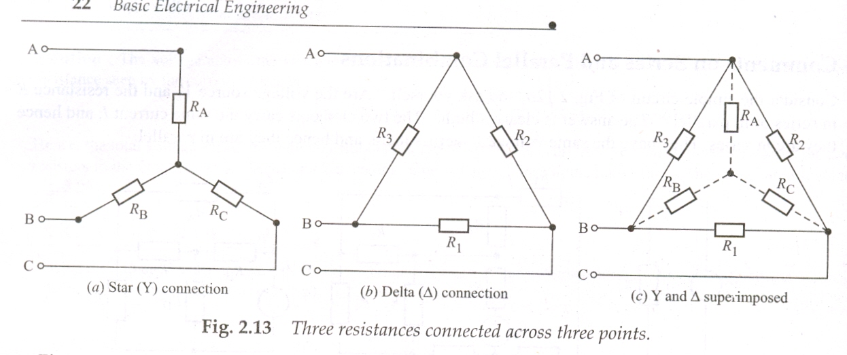
Star-Delta Connections :
Two ways of connecting three resistors across three points.
(a) Star (Y) connection (b) Delta (∆) connection
Next

Slide 95
Delta-to-Star Transformation
Y and ∆ superimposed
Next

Slide 96
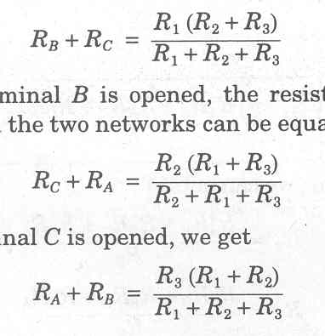
If the two arrangements are to be equivalent, the resistance between any pair of terminals (AB, BC or CA) in the two circuits has to be the same, when the third line is left open.
Keeping terminal A open, we equate the resistance between terminals B and C in the two circuits,
Click
Next

Slide 97
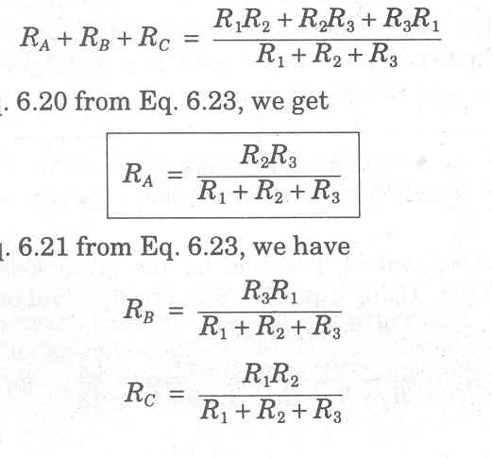
Similarly,
Adding above three equations and dividing by 2, we get
Next

Slide 98
Subtracting,
Remember : Product of two resistances on its sides, divided by the sum of three resistances.
For a symmetrical delta-connection,
Next

Slide 99
Star-to-Delta Transformation
Same way, we can derive,
Remember
The sum of the two nearest resistances plus the product of the same two resistances divided by the third resistance.
Write expressions for R₂ and R₃.
Click
Next

Slide 100
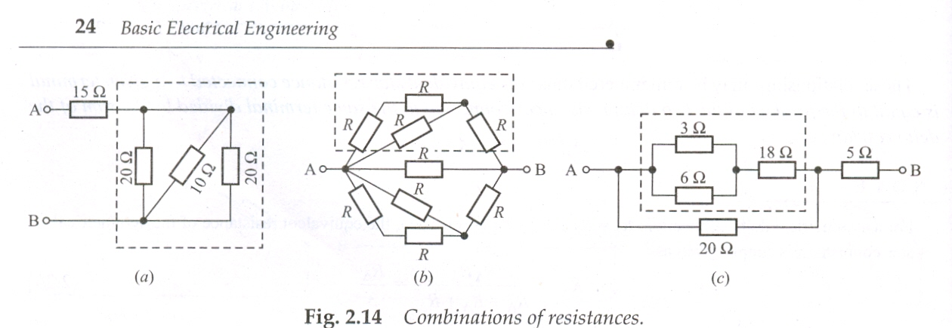
Example 2.5(a) Calculate the effective resistance between points A and B for the combinations of resistances,
Next

Slide 101
Solution : The resistance R_{p} of the network within the dotted box is given by
Therefore,
R_{AB} = 15 Ω + (20 Ω || 10 Ω || 20 Ω)
= 15 Ω + 5 Ω = 20 Ω
Can you suggest some simpler way to solve the problem ?
Click
Click
Alternatively, much easier and quicker solution :
R_{AB} = 15 Ω + (20 Ω || 20 Ω) || (10 Ω)
= 15 Ω + (10 Ω) || (10 Ω) = 15 Ω + 5 Ω = 20 Ω
Next

Slide 102
Example 2.5(b) Calculate the effective resistance between points A and B for the combinations of resistances,
Next

Slide 103
Solution : The resistance of the network within dotted box is
Click
By symmetry, the resistance of the lower network will also be the same, i.e.
Next

Slide 104
Thus, the entire network between points A and B is a parallel combination of three resistances, R₁ (= 5R/3), R and R₂ (= 5R/3).
The combination of R₁ and R₂ is simply 5R/6.
Thus, the net resistance between points A and B is
Click
Next

Slide 105
Example 2.6 Determine the currents I₁, I₂ and I₃ flowing in the parallel branches in the network shown in Figure.
Next

Slide 106
Solution : Find the effective resistance.
Click
The voltage across the three resistances connected in parallel has to be the same.
Click
Solve these equations.
Next

Slide 107
Click
Next

Slide 108
Example 2.7 Calculate the supply current I in the network given, if the 5-Ω resistance dissipates energy at the rate of 20 W.
Next

Slide 109
Solution :
Power,
Click
Using current divider,
Click
Next

